Slide 1

Module 4
Ordinations 1: Distance -based methods

Slide 2
What is ordination?

Slide 3
What is ordination?
Literally: arranging items along a scale
For ecologists: graphically summarizing complex relationships by extracting a few dominant patterns from data composed of correlated variables
IT IS A TYPE OF DATA REDUCTION

Slide 4
What is ordination?
Literally: arranging items along a scale
For ecologists: graphically summarizing complex relationships by extracting a few dominant patterns from data composed of correlated variables
Ordination often helps to:
  select the most important factors
  separate strong from weak patterns
  reveal unforeseen patterns

Slide 5
Types of ordination
Distance-based ordination
  NMDS –Nonmetric Multidimensional Scaling
  PCoA–Principal Coordinates Analysis
Eigenanalysis-based ordination
  PCA –Principal Components Analysis
  CA –Correspondence Analysis
  DCA –Detrended Correspondence Analysis
  CCA –Canonical Correspondence Analysis
  RDA –Redundancy Analysis

Slide 6
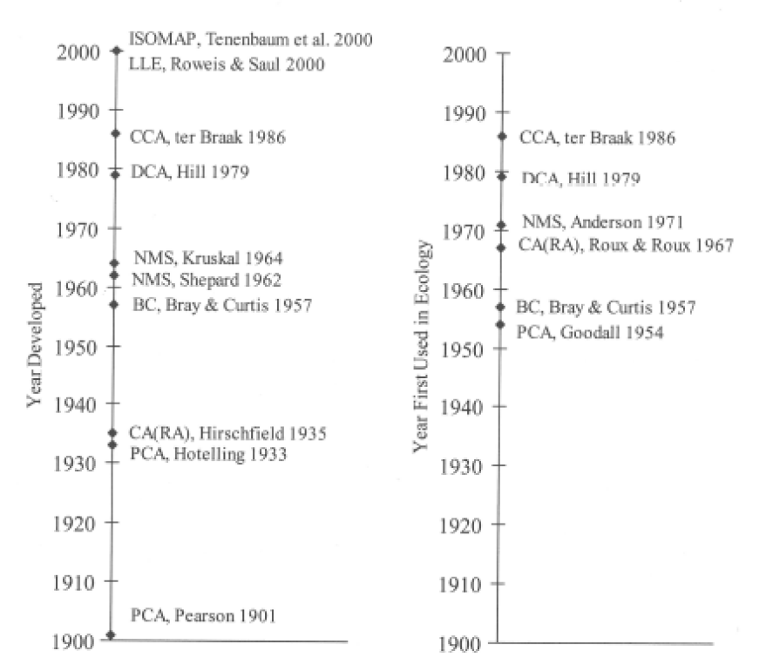
Types of ordination

Slide 7
Types of ordination
Distance-based ordination
attempt to faithfully relate differences in ordination space to distance (or dissimilarity)
Eigenanalysis-based ordination
attempt to faithfully place species or attributes along gradients (inferred or measured)

Slide 8
Types of ordination
Distance-based ordination
  NMDS –Nonmetric Multidimensional Scaling
  PCoA–Principal Coordinates Analysis (metric multidimensional scaling)
Eigenanalysis-based ordination
  PCA –Principal Components Analysis (a special case of PCoA)
  CA –Correspondence Analysis
  DCA –DetrendedCorrespondence Analysis
  CCA –Canonical Correspondence Analysis
  RDA –Redundancy Analysis

Slide 9
NMDS vs. PCoa
NMDS
PCoA
A Visualization Technique
Does not create a unique solution
Dissimilarities are distorted
Stress doesn’t indicate amount explained by axes
An Analytical Technique
Attempts to explain variation in the data
Dissimilarities not distorted
Can get axes of variation

Slide 10
NMDS: Nonmetric MultiDimensional Scaling
Advantages
  Avoids assumption of linear relationships
  Allows the use of any distance measure or relativization
  Uses ranked distances, which tends to linearize the relationship between distances in species space and those in environmental space
Disadvantages (historically)
  Failing to find the best solution
  Computationally intensive (slow to run)
Greater computational power = now the method of choice for community data (McCune & Grace 2002)

Slide 11
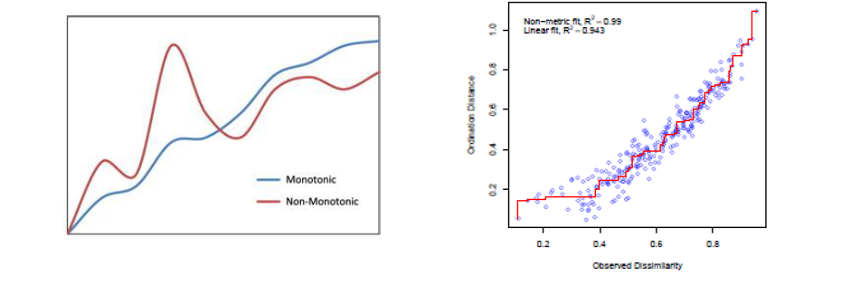
NMDS –the procedure
An iterative search for the best positions of communities (entities) on a specified number of axes that minimizes the “stress” of the system
Stress measures the departure from monotonicity in the relationship between the original distances (dissimilarities) and distance in ordination space

Slide 12
NMDS –the procedure
An iterative search for the best positions of communities (entities) on a specified number of axes that minimizes the “stress” of the system
Stress measures the departure from monotonicity in the relationship between the original distances (dissimilarities) and distance in ordination space
Think of optimizing stress as: “Pulling on all points a little bit so no single point is completely wrong, all points are a little off compared to distances”

Slide 13
NMDS –the procedure
Calculate a dissimilarity matrix
Using a random number generator, assign entities to a starting configuration in ordination space and normalize
Calculate the Euclidean distances (d) between entities in ordination space
Rank the dissimilarities in ascending order and put the ordination distances in the same order
Replace ordination distances that do not satisfy the monotonic relationship with elements d^

Slide 14
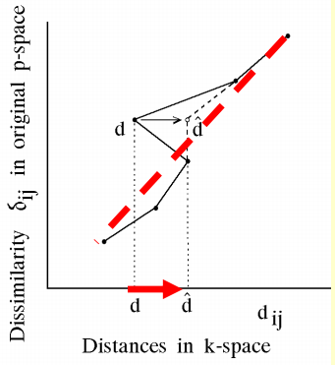
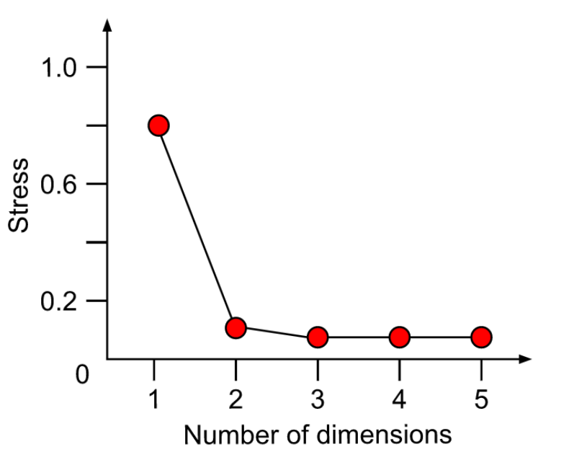
NMDS – the procedure: stress
Stress is calculated from the changes made to satisfy monotonicity
  If stress = 0, the relationship is perfectly monotonic

Slide 15
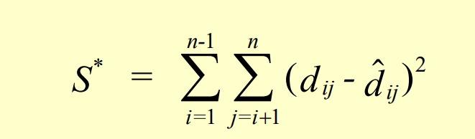
NMDS – the procedure: stress
Stress is calculated from the changes made to satisfy monotonicity
  If stress = 0, the relationship is perfectly monotonic

Slide 16
NMDS – the procedure: stress
Stress is calculated from the changes made to satisfy monotonicity
  If stress = 0, the relationship is perfectly monotonic
Then we try to minimize stress by changing the configuration and calculating the gradient of stress between the configurations
Iterate until either a stability criterion is met (i.e. low variability in stress over recent iterations) or the specified number of iterations is met
Re-run the model with other random starting configurations until multiple runs converge on a solution

Slide 17
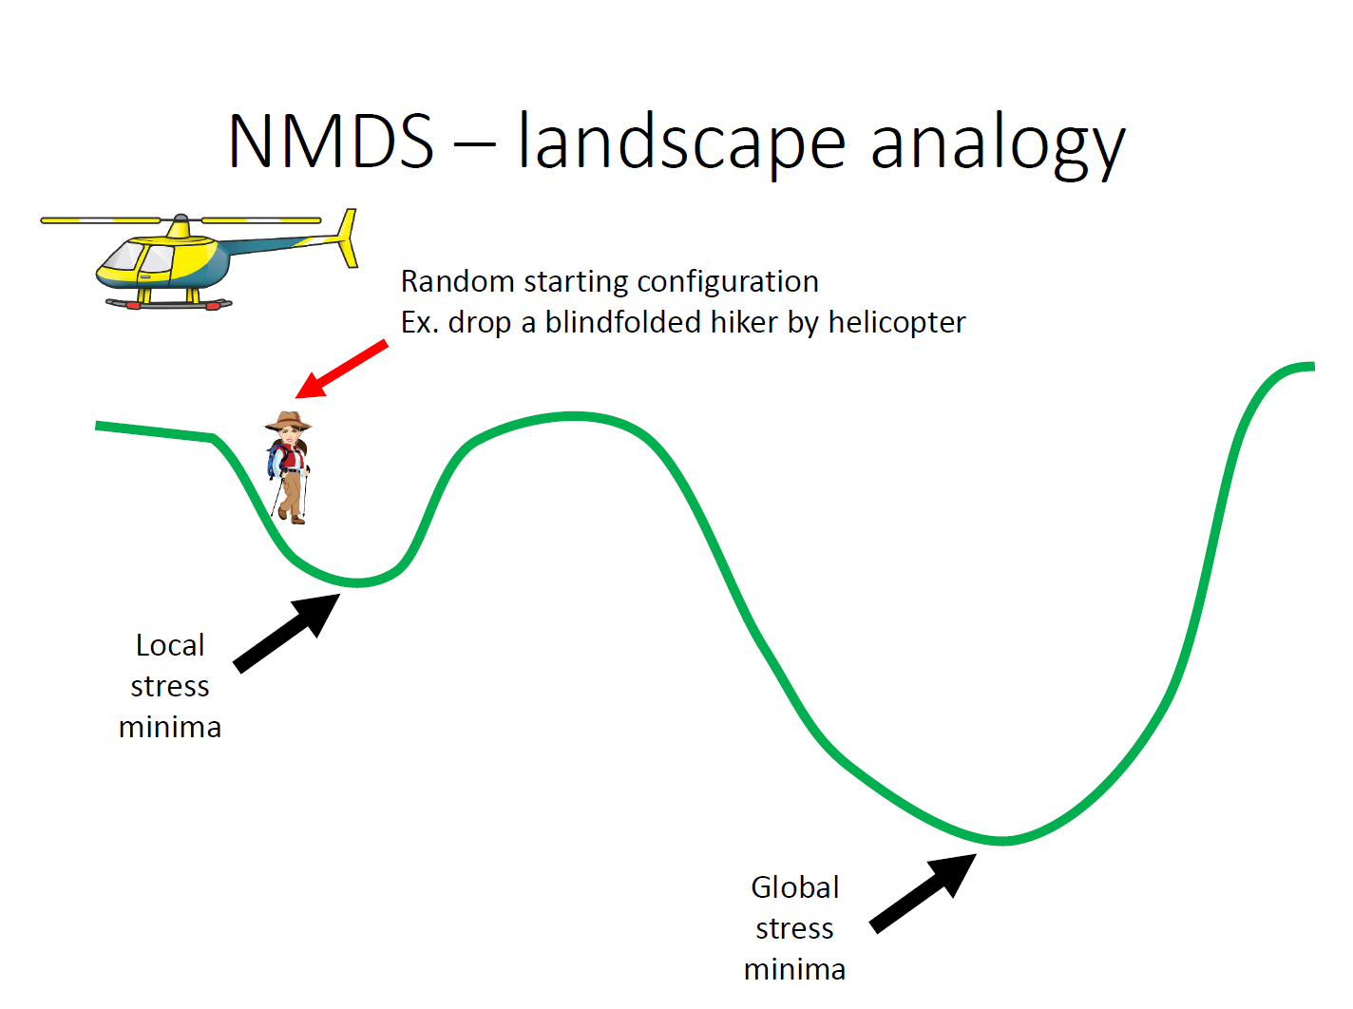


Slide 18
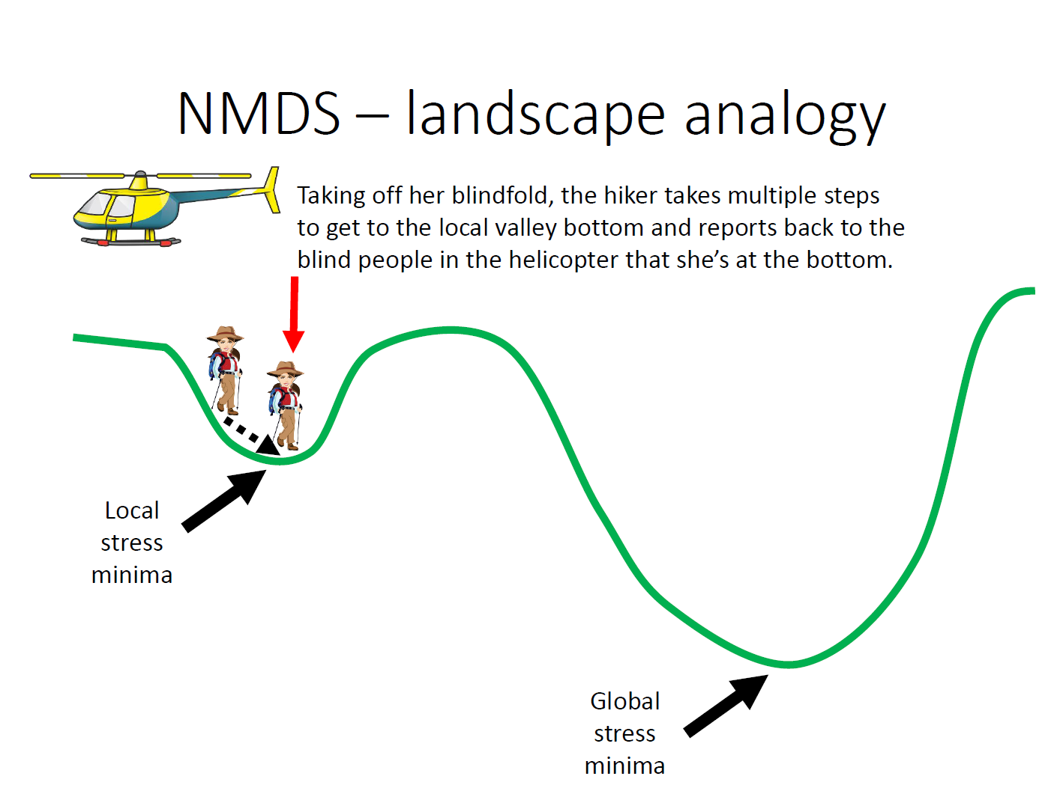

Slide 19
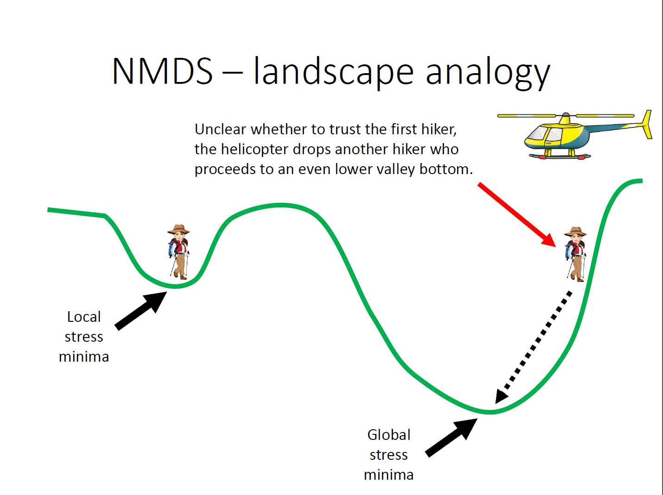

Slide 20
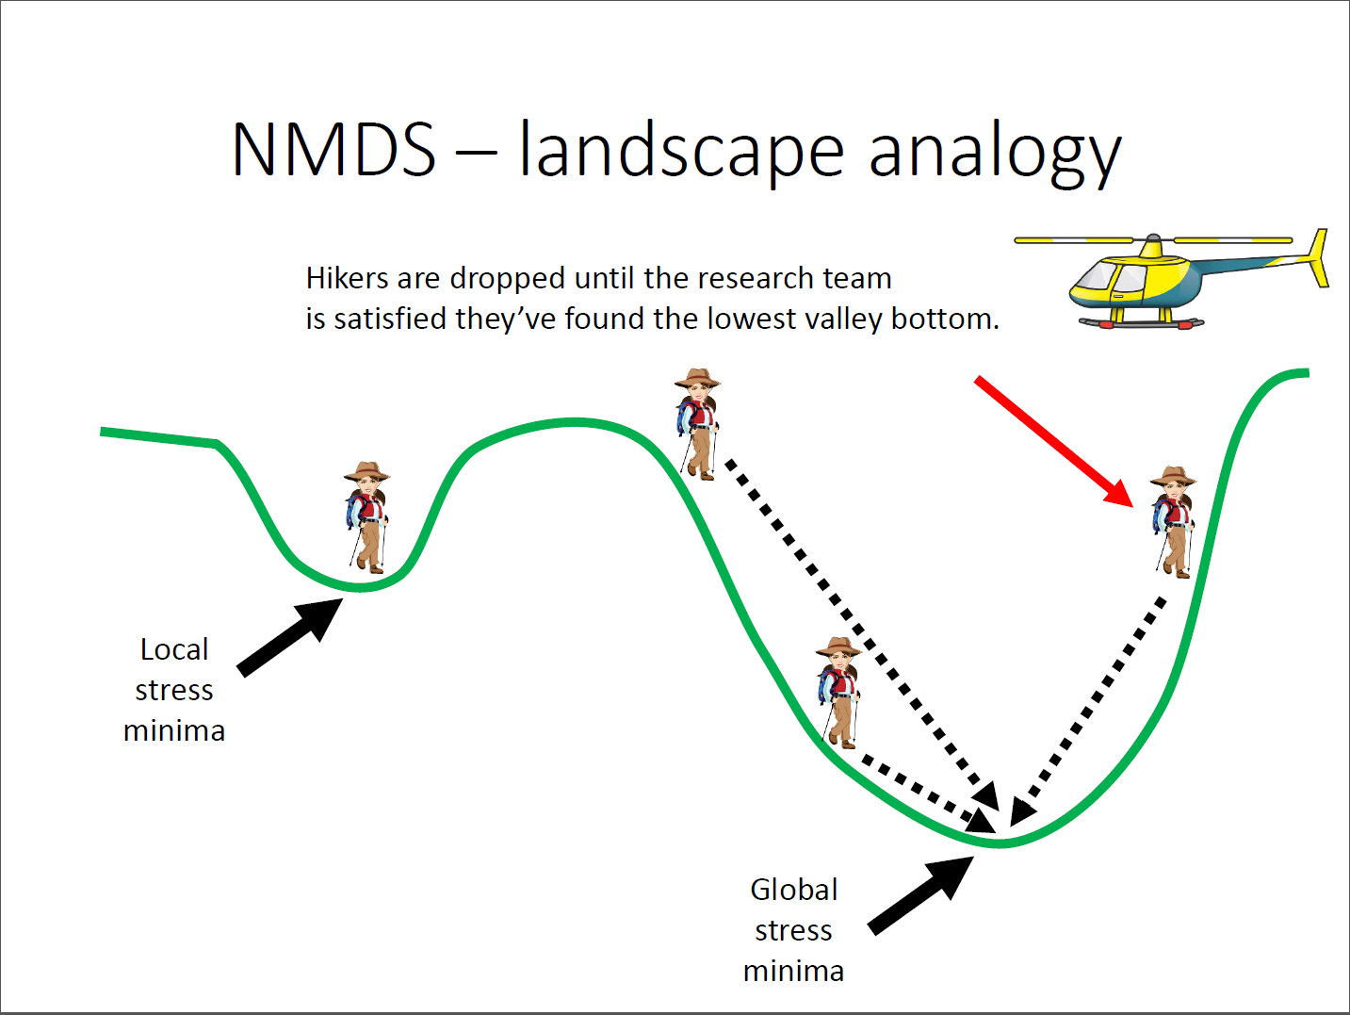

Slide 21
NMDS -stress
Rules of thumb:
< 0.05 is excellent
0.05-0.1 is good
0.1-0.2 is fair
0.2-0.3 is cause for concern…
> 0.3 is poor, random

Slide 22
NMDS -stress
Rules of thumb:
< 0.05 is excellent
0.05-0.1 is good
0.1-0.2 is fair
0.2-0.3 is cause for concern…
> 0.3 is poor, random
…however, we should not over-rely on these rules.
Greater sample size leads to greater stress
Another rule of thumb is to make sure sample size is over 4x greater than dimensionality

Slide 23
Reading a NMDS plot
Objects that are ordinated closer to one another are likely to be more similar than those further apart.
The scale of the axes is arbitrary as is the orientation of the plot.
Solutions with higher stress values are highly suspect.
Tight clusters of points that are well-separated from other clusters may indicate sub-populations in the data.
  Be aware that if a cluster of points is very dissimilar from other points or clusters, the arrangement of points in that cluster may not be very meaningful.
  The stress of the solution would be minimally affected by rearranging points in a tight cluster.
  Re-running an NMDS with only those objects in a given cluster may reveal more informative patterns.

Slide 24
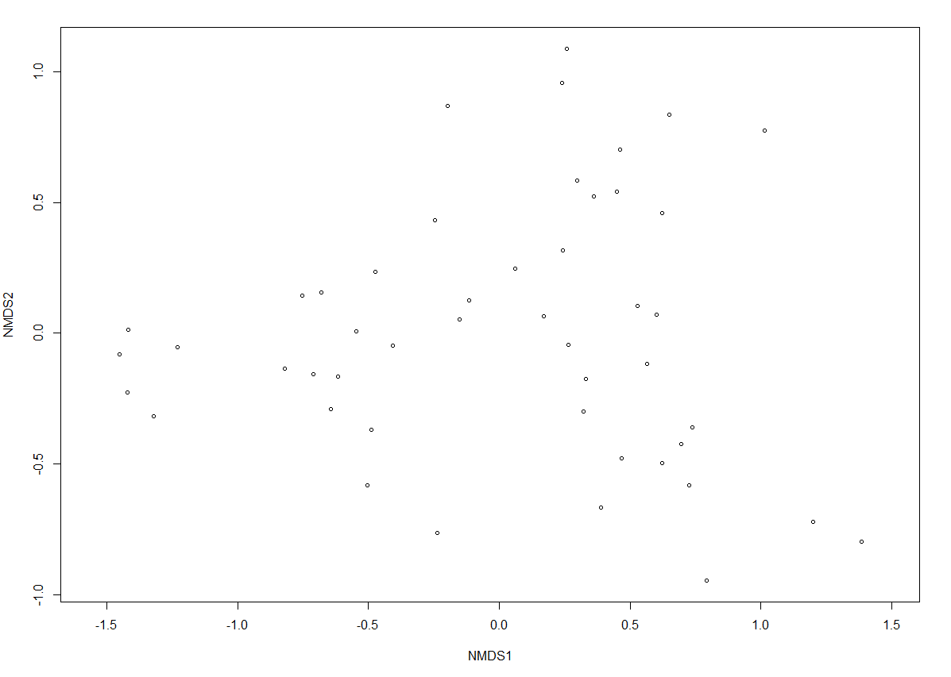
Reading a NMDS

Slide 25
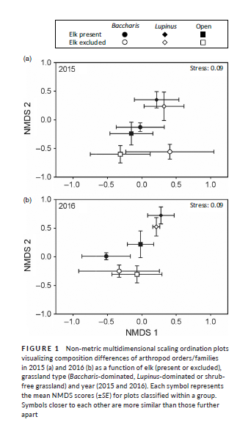
Reading a NMDS

Slide 26
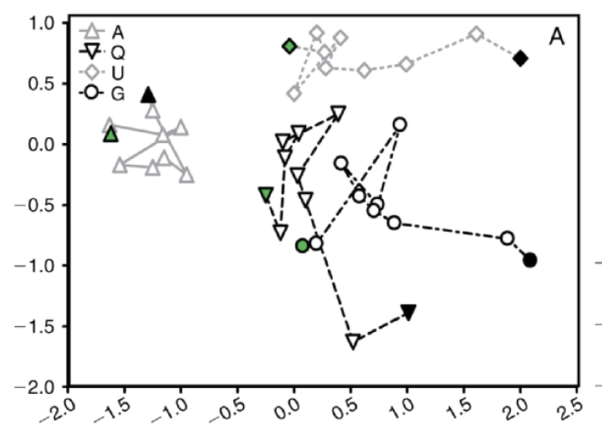
Reading a NMDS

Slide 27
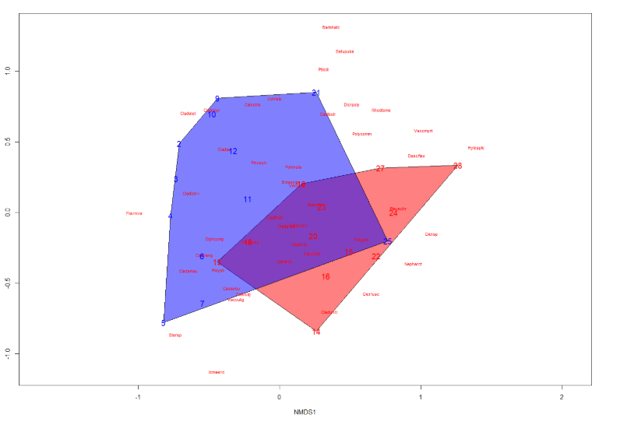
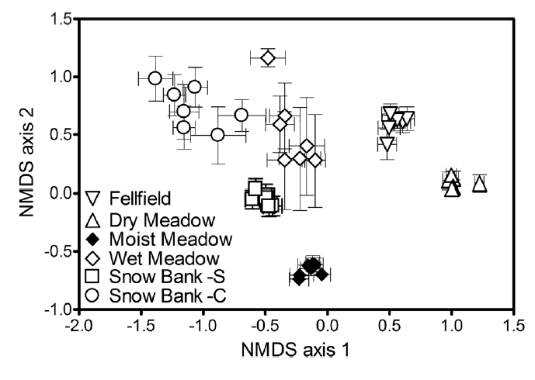
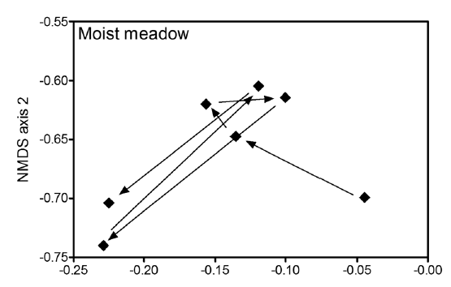
Plotting a NMDS

Slide 28
Principle Coordinates Analysis
Synonyms to know and avoid using:
  Multidimensional scaling (MDS)
  Metric multidimensional scaling
It is conceptually similar to PCA and attempts to represent the distances between samples in a low-dimensional, Euclidean space
However, PCoA can preserve distances generated from any (dis)similarity measure (PCA can’t) allowing more flexible handling of complex ecological data.
  Phylogenetic data (microbial ecology)

Slide 29
PCoA vs. NMDS
PCoA
NMDS
An Analytical Technique
Attempts to explain variation in the data
Dissimilarities not distorted
Can get axes of variation
A Visualization Technique
Does not create a unique solution
Dissimilarities are distorted
Stress doesn’t indicate amount explained by axes

Slide 30
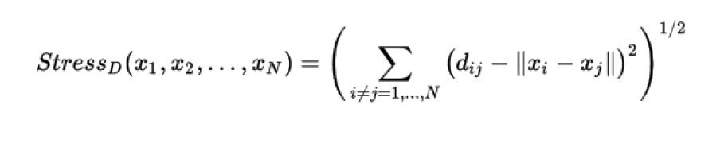
PCoA
Maximizes the linear correlation between dissimilarities and ordination distances
Can use any dissimilarity or distance measure
Less computationally demanding than NMDS
Uses an optimization strategy called “stress majorization”, which minimizes “stress” based on residual sums of squares:

Slide 31
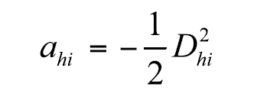
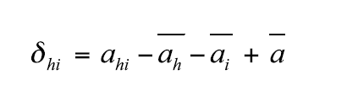
PCoA – the procedure
Calculate a dissimilarity matrix D
Matrix D is transformed to a new matrix A
Matrix A is centered to give matrix ∆₁
The eigenvalues and eigenvectors are computed and scaled
  [This is linear algebra stuff – watch some YouTube Videos]

Slide 32
eigenvalues and eigenvectors?
Eigen = German for characteristic
Eigenvector and Eigenvalue can give you the information on the scaling and rotational characteristics of a Matrix.
Scaling
rotation

Slide 33
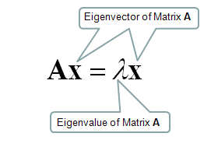
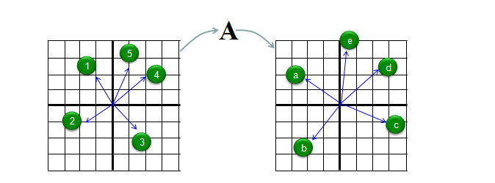
eigenvalues and eigenvectors?
Eigenvector and Eigenvalue can give you the information on the scaling and rotational characteristics of a Matrix.

Slide 34
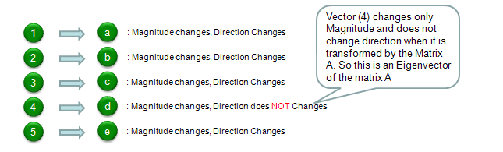
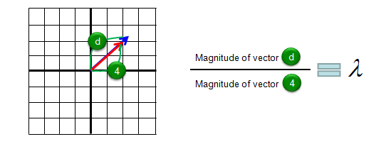
eigenvalues and eigenvectors?
Eigenvector and Eigenvalue can give you the information on the scaling and rotational characteristics of a Matrix.
This is the eigenvector of the transformation and is the axis of rotation
Eigenvalue is how much it is stretched or squished

Slide 35
eigenvalues and eigenvectors?
Eigenvector and Eigenvalue can give you the information on the scaling and rotational characteristics of a Matrix.
Negative eigenvalues
  OK if the largest negative eigenvalues are smaller in absolute magnitude than any of the first three positive eigenvalues of interest
  Make corrections (add a value)
Follow the rules provided by Legendre and Legendre (1998).
  More on this next lecture

Slide 36
PCoA – the procedure
After scaling, the eigenvalues and eigenvectors are written as columns and the rows are the coordinated in PCo space.

Slide 37
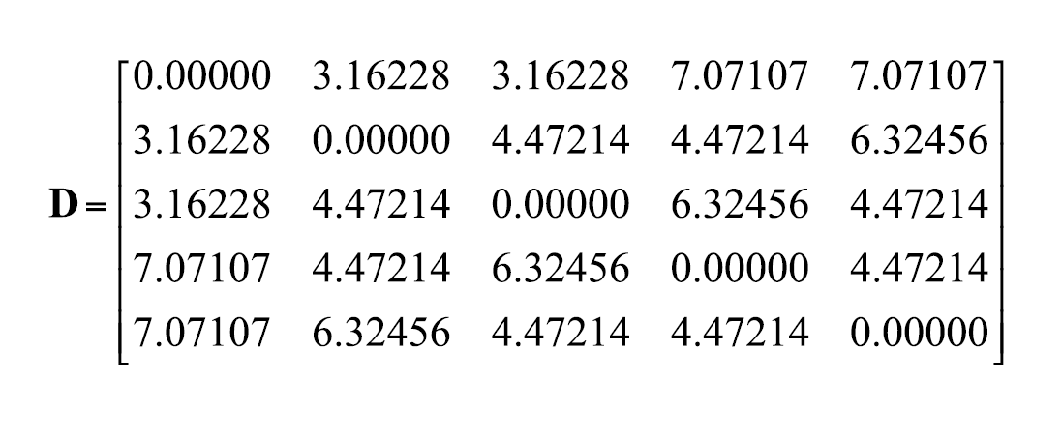
PCoA - Numerical Example

Slide 38
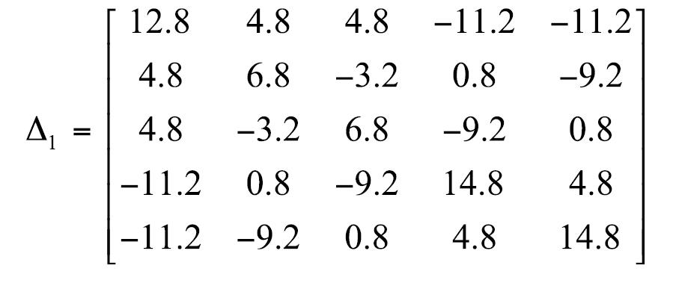
PCoA - Numerical Example

Slide 39
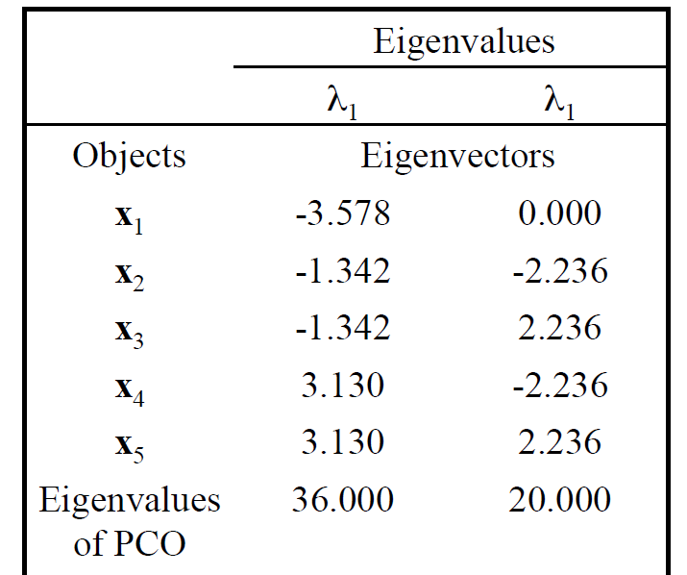
PCoA - Numerical Example

Slide 40
Thursday’s homework
Identify your dataset for your final project and talk to me about it in class.
  Your data
  Exercise data
  Data from the web

